Slide 1

Grammer auto corrector
This capstone project is about developing a comprehensive grammar auto-corrector. The tool aims to assist users in enhancing their writing by automatically detecting and correcting various grammatical errors, including incorrect verb tenses, subject-verb agreement issues, punctuation errors, and misused words.

Slide 2
Introduction
In the digital age, where written communication spans emails, social media posts, professional documents, and casual texts, maintaining correct grammar is more crucial than ever. This is where grammar auto correctors come into play.
A grammar auto corrector is a sophisticated tool designed to enhance your writing by identifying and correcting grammatical errors, spelling mistakes, and punctuation issues in real-time.
The functionality of grammar auto correctors has evolved significantly over the years. Early versions were primarily focused on basic spell-checking, but modern tools are much more advanced.
They can detect complex grammatical errors, contextual spelling mistakes, stylistic issues, and even suggest alternative vocabulary to improve readability and tone.

Slide 3
Literature review
Review:
Moreover, grammar auto-correctors contribute to better communication.
Clear and error-free writing is essential for conveying messages accurately and professionally.
Another significant benefit is the accessibility and ease of use of these tools.

Slide 4
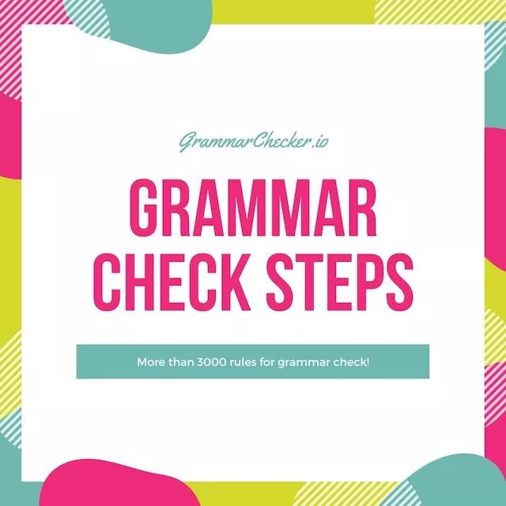
Methodologies
Grammar auto correction tools employ a variety of methodologies to identify and correct errors, leveraging advancements in computational linguistics, natural language processing (NLP), and machine learning.
Modern approaches heavily rely on machine learning and deep learning, employing supervised learning, neural networks, and sequence-to-sequence models to learn from labeled datasets
Statistical methods, such as n-gram models and probabilistic models, analyze the likelihood of word sequences to detect anomalies in usage and order.

Slide 5
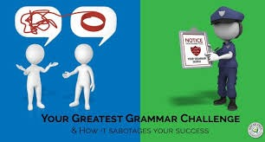
Challenges and future work:
Contextual understanding:
Ambiguity : Differentiating between homophones and contextually ambiguous words remains difficult. For example, distinguishing between "their" and "there" based on context can be challenging.
User Interface : Designing intuitive and user-friendly interfaces that provide corrections without disrupting the writing flow.
Platform Compatibility: Ensuring seamless integration with various platforms, including web browsers, word processors, and mobile devices, without performance issues

Slide 6
Discussion:
In this Study, the performance of the summarizer was evaluated by comparing it with a baseline summarizer.
The results show that the summarizer is able to generate summaries that are generally more accurate and informative than the baseline summarizer. However, there are still limitations to the summarizer's performance, such as the need to handle complex text structures.

Slide 7
Conclusion :
In conclusion, grammar auto correction tools play a pivotal role in enhancing the accuracy and clarity of written communication, yet they face several challenges that necessitate ongoing research and development. Addressing issues such as contextual understanding, multilingual support, accuracy improvements, usability enhancements, and personalized adaptation remains crucial for advancing these tools.

Slide 8
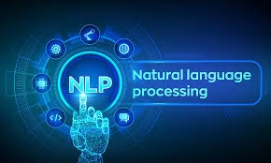
Future work:
Advanced NLP Techniques:
Utilizing more sophisticated natural language processing techniques to improve contextual understanding and handle nuances better.
Context-Aware AI Models:
Expansion to More Languages:
Increasing support for a wider range of languages and dialects with high accuracy.
Developing AI models that can better understand the broader context of text, leading to more accurate and contextually appropriate corrections.

Slide 9

This Photo by Unknown Author is licensed under CC BY-NC

